Slide 1
Ultralite Coding
Spencer Lofing, Ben Finnerty, Tyler Hogenson, Max Maier, Nicholas Walter

Slide 2
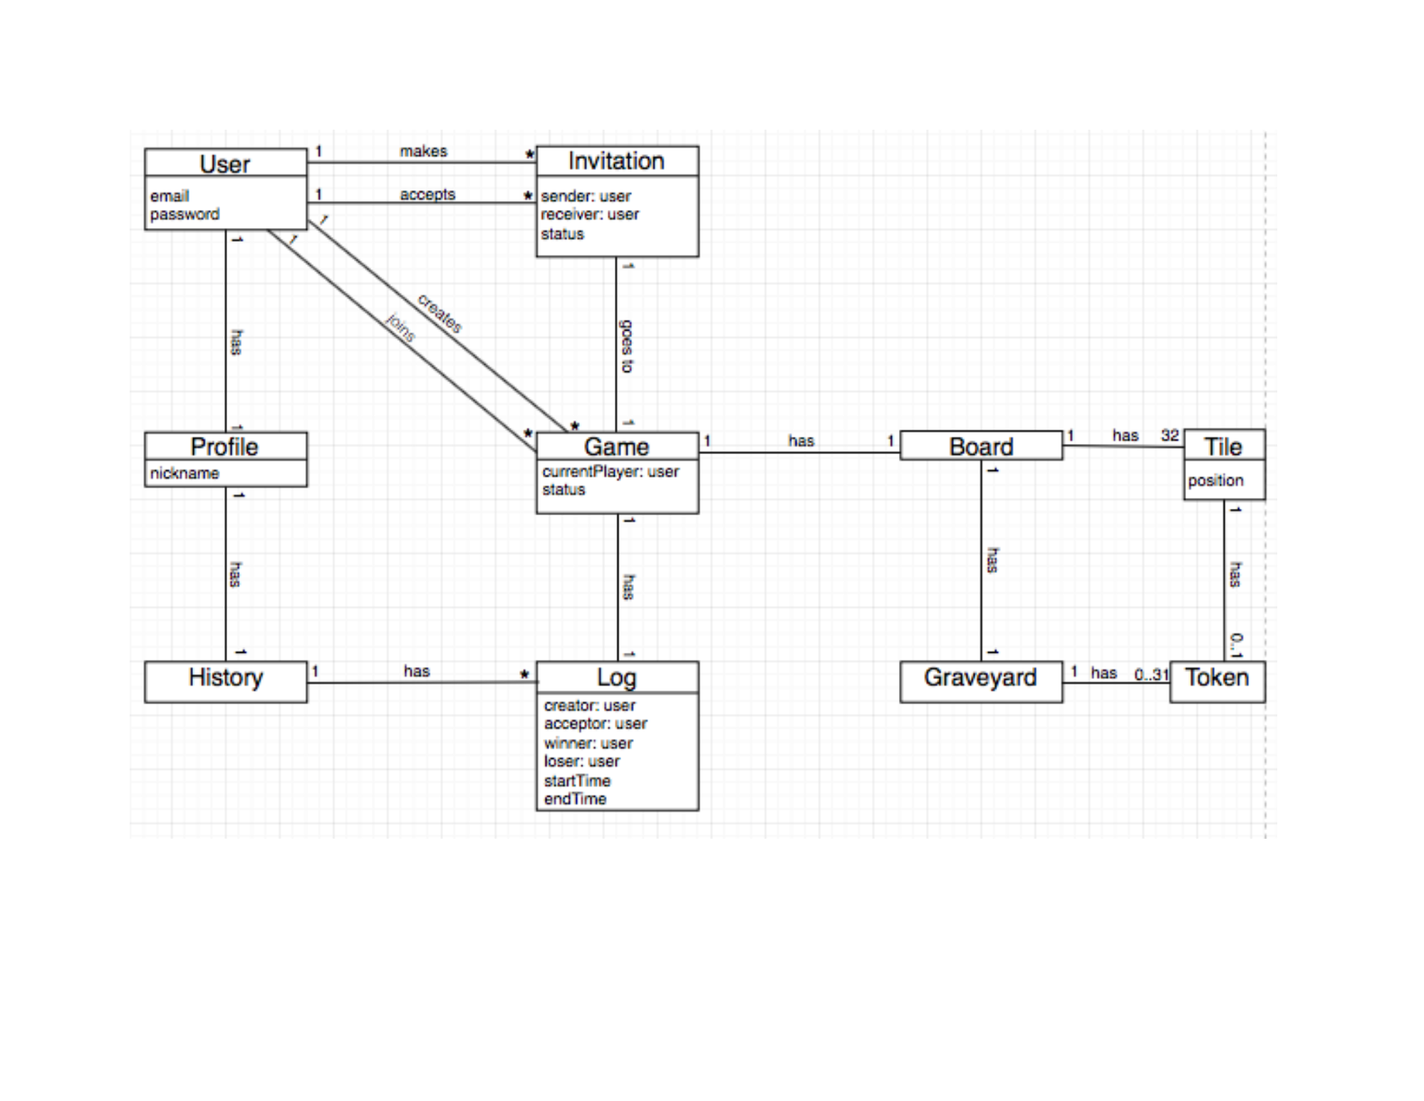
Updated Domain Model

Slide 3
Traceability Link Matrix

Slide 4
Sequence Diagrams

Slide 5
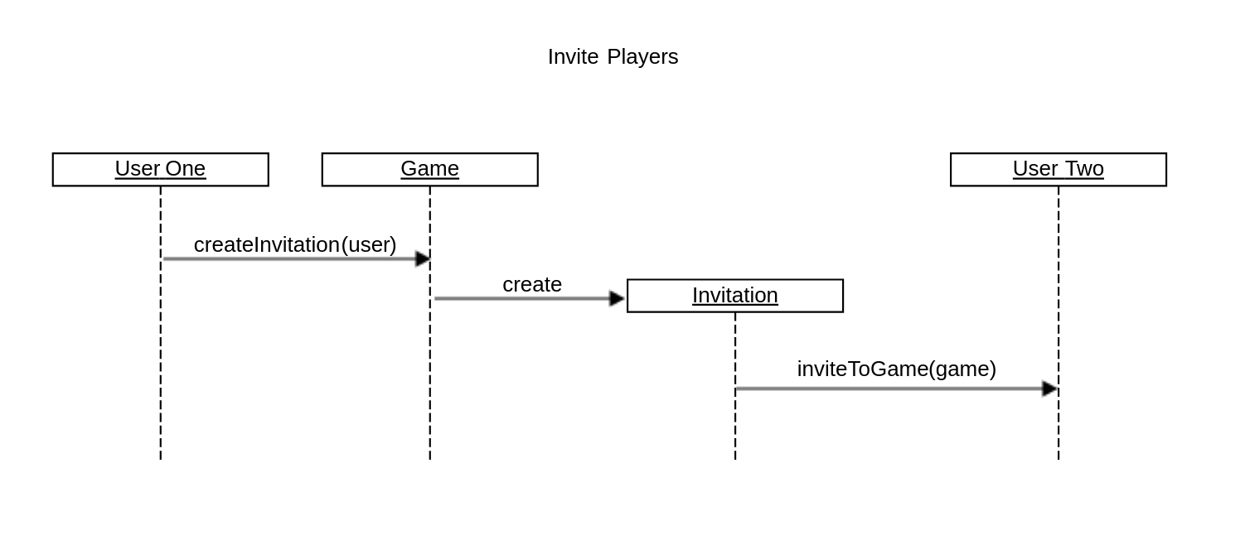
Invite Players

Slide 6
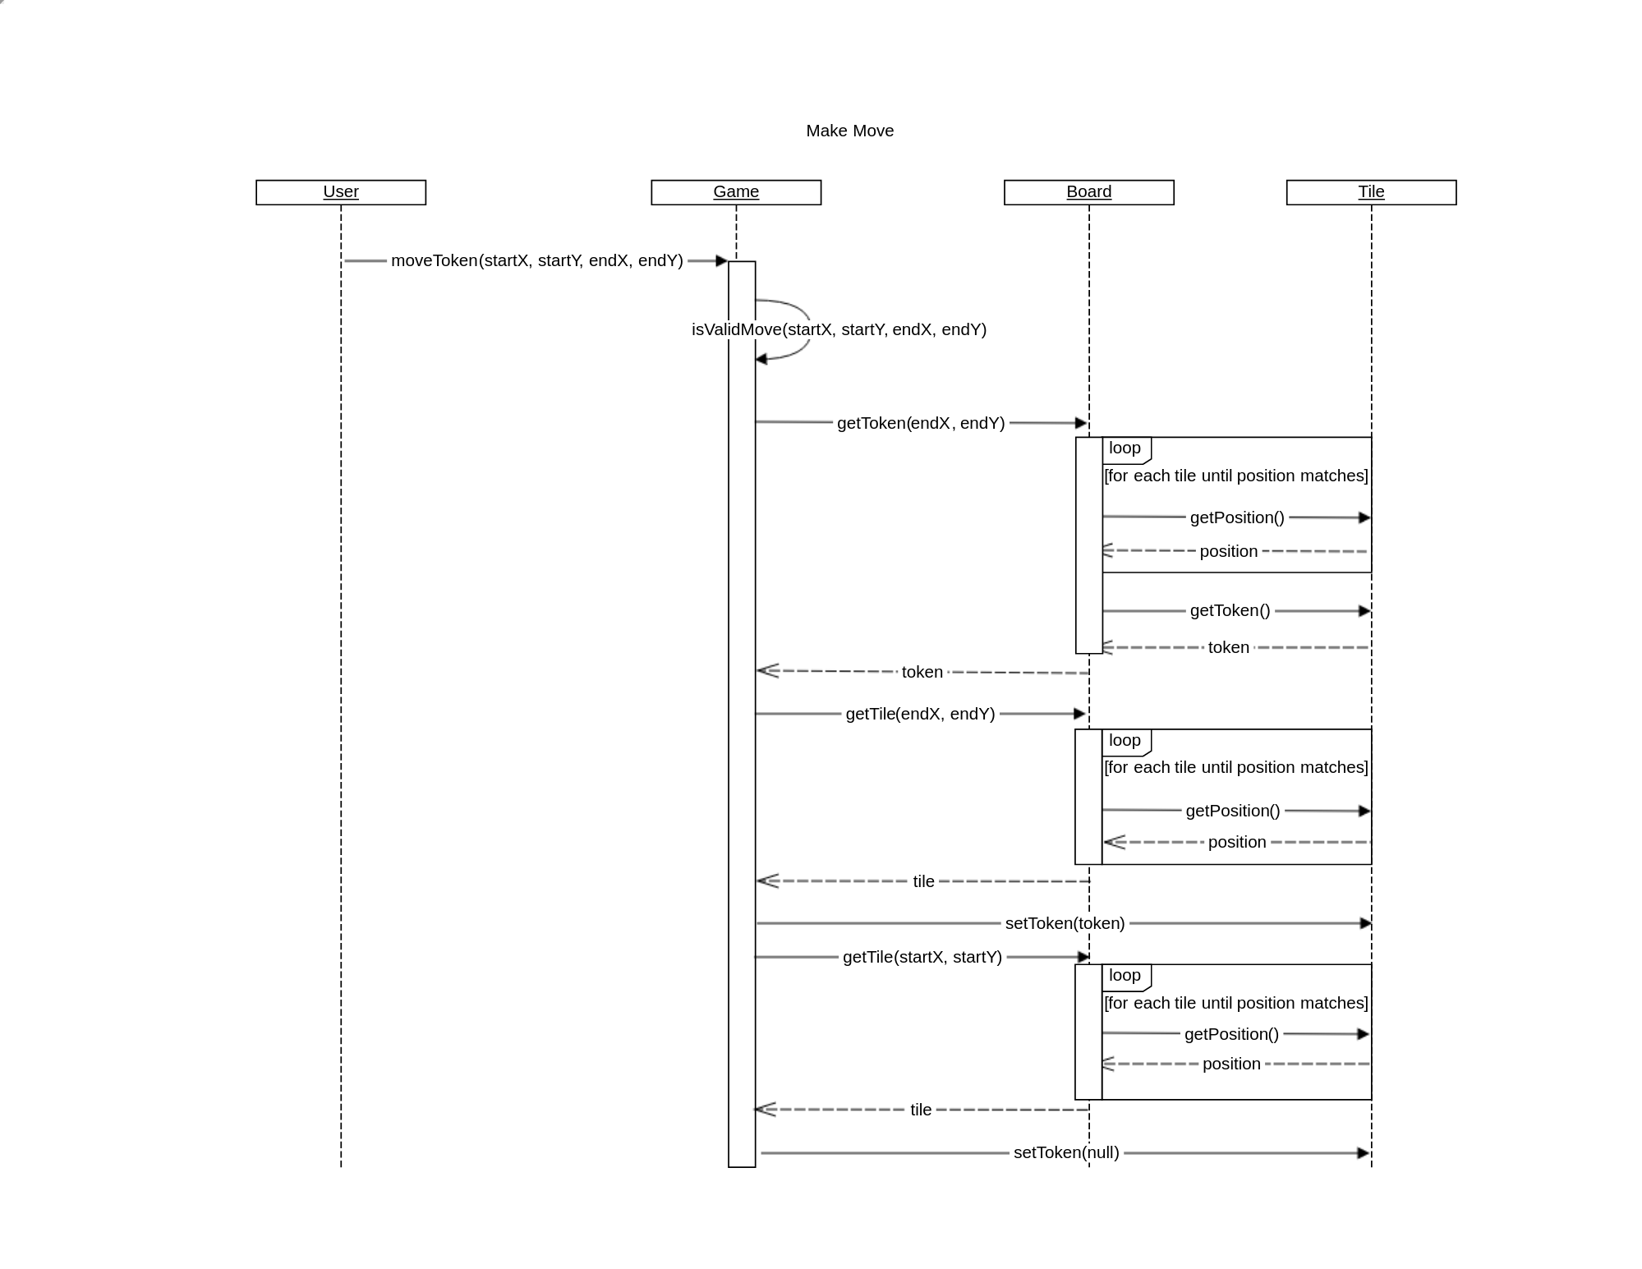
Make Move

Slide 7
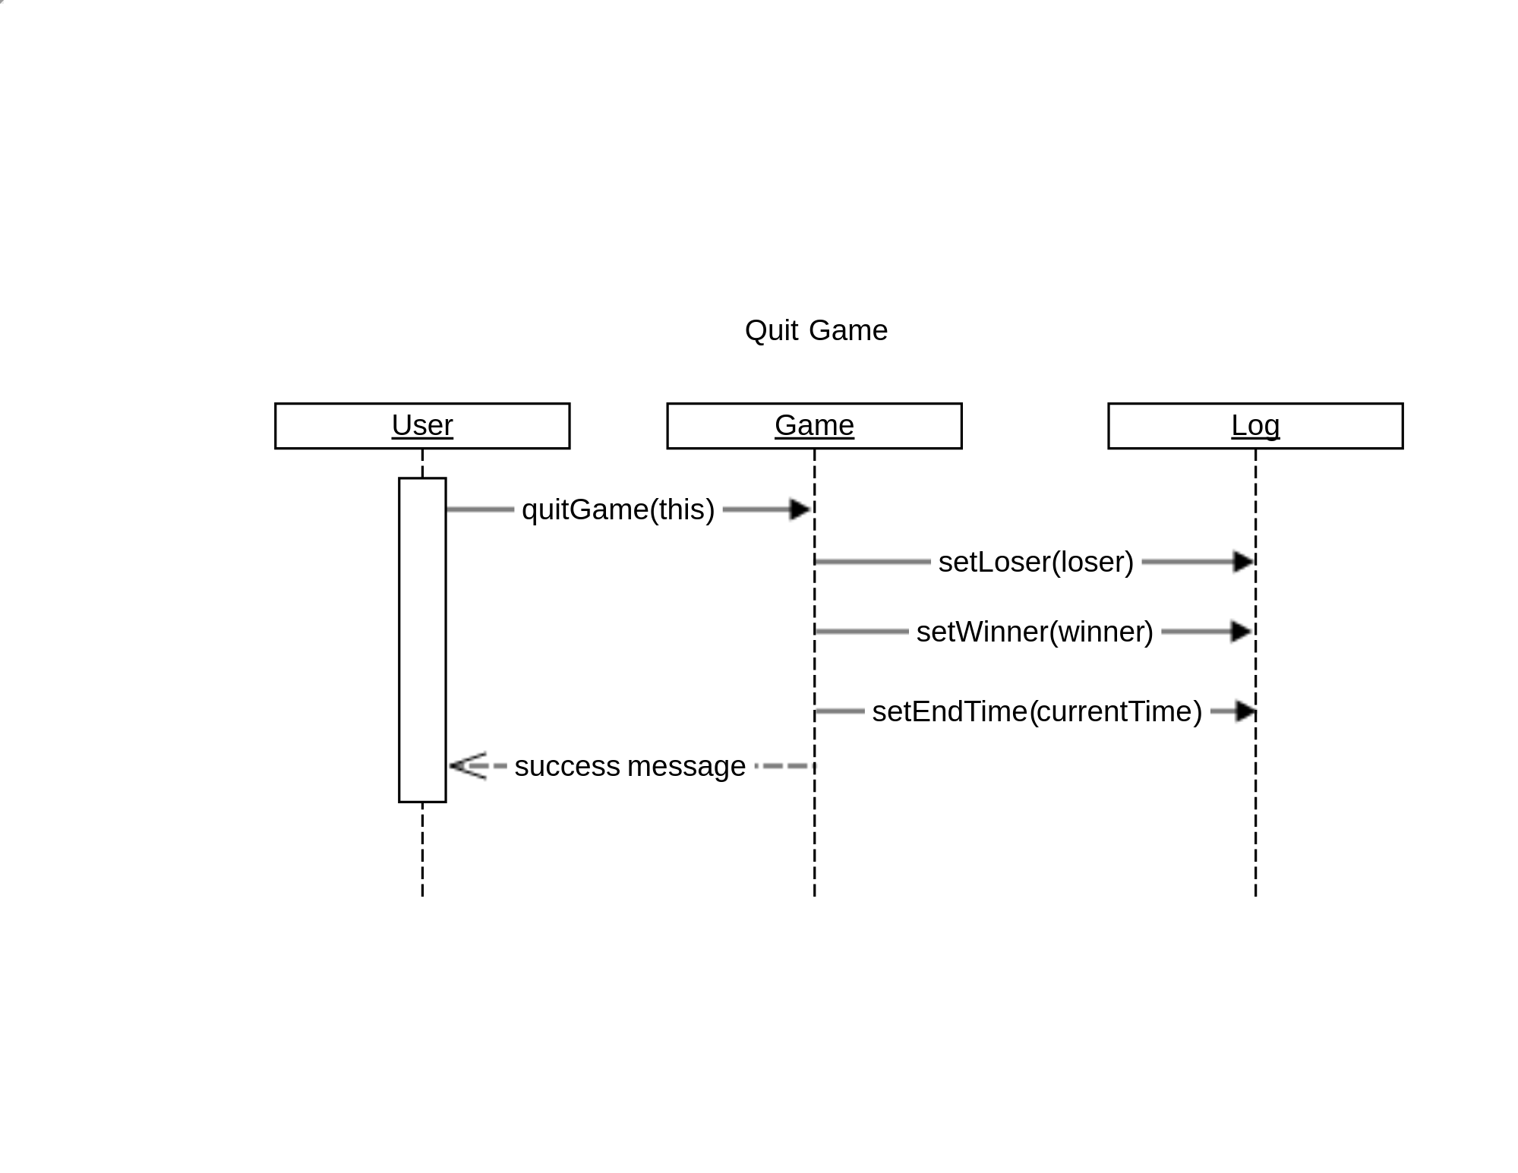
Quit Game

Slide 8
Design Class Diagram

Slide 9
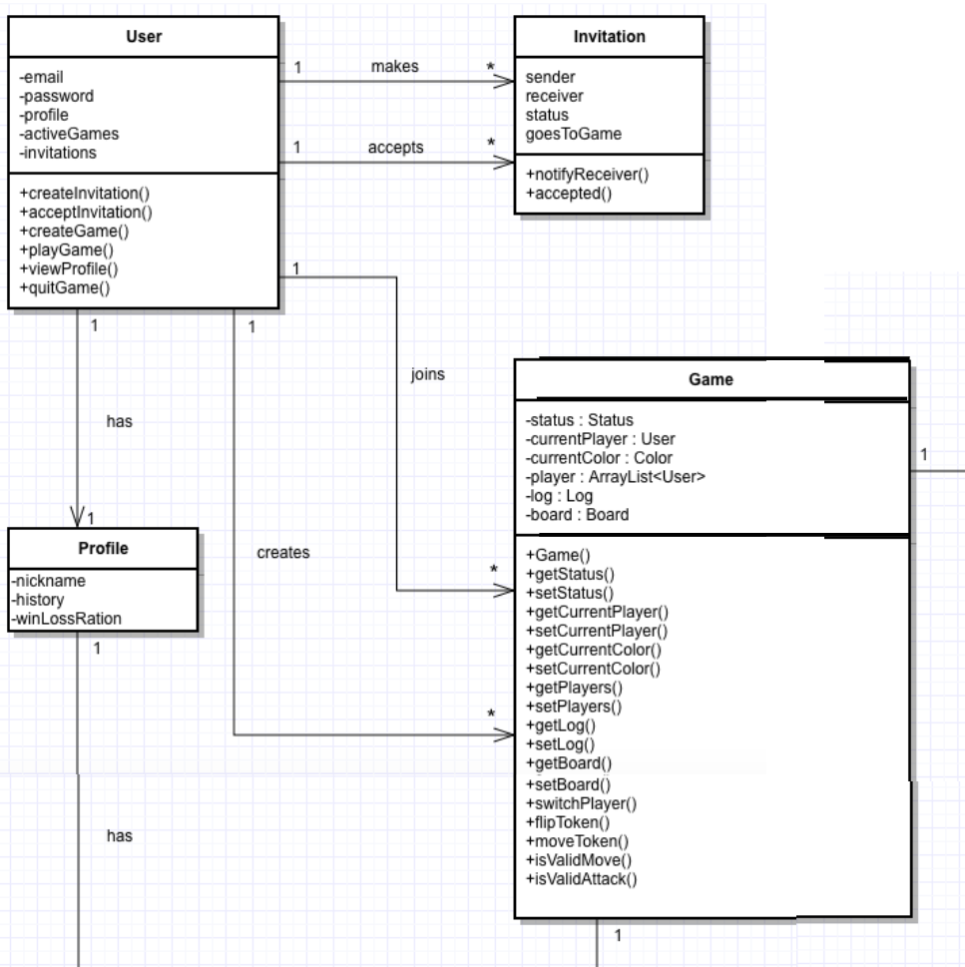
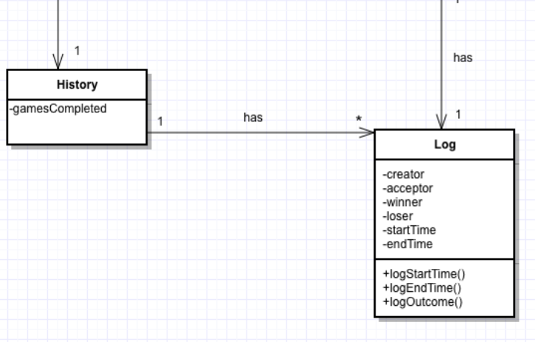

Slide 10
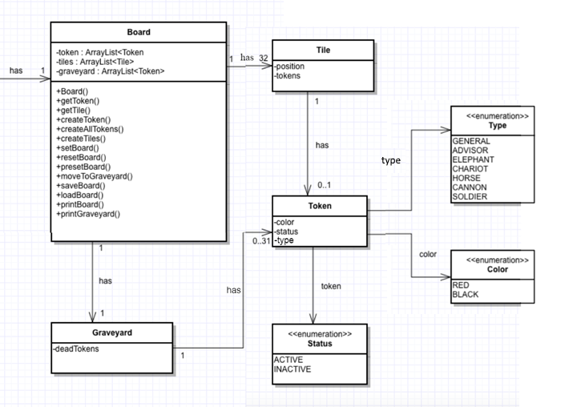

Slide 11
Demo

Slide 12
Questions?

